Slide 1
The Kingsmen Way
The Kingsmen Way enables our teams to grow quality software and deliver in an iterative manner, crafting a solution that works best for our customers. Instrumental in this is the refinement, product management and business analysis that leads to the solution. We start with a customer's vision and elaborate additional levels of detail until we understand enough to complete daily tasks.
Levels and Work Item
1
Vision – Capability
1
2
3
4
5
2
Road Map – Feature
3
Release – Function
4
Iteration – User Story
5
Daily – Task

Slide 2
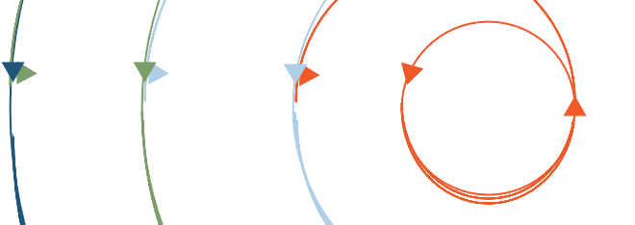
5 Levels of Continuous Refinement
1
2
3
4
5
Capability
Feature
Function
Story
Task
TIMING
Annual
Semi-annual
Quarterly
Bi-weekly
Daily
PARTICIPANTS
Product owner
Product owner
Product owner & feature team
Product owner & feature team
Feature team
Business objective or outcome of the product or program
What the product does, a grouping of functionality
What the product does, a single piece of functionality
A set of discrete user activities in a function
Activity needed to complete a story
WORK ITEM DEFINITION
Ongoing or spans multiple releases
Spans multiple releases
WORK ITEM SCHEDULING
Single release
Single iteration
One day-ish

Slide 3
5 Levels of Continuous Planning
1
2
3
4
5
Planning Definitions
We identify the long-term vision for the product including strategy, boundaries and goals. Team knows why they are working, what they are working on and what constraints they must work within.
We’ll establish a rough timeline of high-level features and characteristics the product will deliver to achieve the vision. Includes: Identifying product features, arranging product features into themes, estimating t-shirt size (order of magnitude) and priority of features and determining high level timeframe.
We’ll determine releases defined by date, theme and made up of functions to be delivered in a given timeframe. Only scope, not time or quality, is variable. Team commits to the scope and iterations – typically two to four months.
The work our team will do to deliver the portion of the functions in this cycle. Functions are now broken down into stories and tasks. Team commits to delivery for the iteration with confidence in exactly how the work will be done.
Our team’s work to deliver against the stories in the current iteration. Includes a daily standup to outline a plan for “yesterday, today and any impediments”.
VISION
1
ROADMAP
2
RELEASE
3
ITERATION
4
DAILY
5

Slide 4
Lean-Agile Operating Model - Overview
Portfolio
Strategic Capabilities
Features
MVPs
Program
Functions
Team
In a Lean-Agile operating model, the overall objective is to enable the continuous flow of value aligned to business strategy.
An efficient, high-performing system ensures that activities at all levels of the organization contribute to delivering the right technology solutions in the right way.
Stories
Tasks

Slide 5
Lean-Agile Layers & Objectives
Portfolio
Define Objectives & Vision
Define strategic capabilities & translate into features
Own & steer the roadmap
Align funding & resources to value streams objectives
Strategic Capabilities
Features
MVPs
Program
Organize, Prioritize & Plan
Define scope into rolling backlogs; flow work to teams
Lead prioritization & release planning
Synchronize delivery teams
While each layer of the operating model stays engaged and active at every level, focus shifts as work flows closer to the customer or end user.
Functions
Team
Deliver Incrementally
Detailed scope elaboration & sizing
Iteration planning, demo & retro
Get predictable with capacity
Stories
Tasks

Slide 6
Drive From Business Value – The Flow of Scope
Portfolio
Line of Sight from Strategy to Task
Strategic Capabilities
Features
MVPs
Program
Functions
Team
Stories
Tasks

Slide 7
Drive From Business Value – The Flow of Scope
We focus here.
Enterprise
Portfolio
Program
Team
Where strategy is set & governed
Where strategy is mapped to execution
Where work is organized & planned
Where work
gets done
Executives
Executive PMO
Finance
Portfolio Managers
Project Management Offices
Business Owners
Architects
Product Managers
Program Managers
Technical Leads
Release Train Engineers
Agile Teams
DevOps Teams
Shared Service Teams

Slide 8
Planning Across Three Layers
Work Item | Owners | Timeboxes
Strategic Capabilities & Features | Business Executives & Tech Portfolio Managers | Annual Plans (Years)
Functions (MVPs, Roadmaps) | Business Product Owners & Tech Program Managers (+ platform shared services) | Program Increments & Releases (Quarters → Months)
Stories & Tasks | Dedicated, Cross-Functional Agile Teams (Multiple; geared for demand) | Iterations (Weeks)
Define Objectives & Vision
Define strategic capabilities & translate into features
Own & steer the roadmap
Align funding & resources to value streams objectives
Portfolio
Organize, Prioritize & Plan
Define scope into rolling backlogs; flow work to teams
Lead prioritization & release planning
Synchronize delivery teams
Program
Deliver Incrementally
Detailed scope elaboration & sizing
Iteration planning, demo & retro
Get predictable with capacity
Team

Slide 9
Continuous Planning
Continuous Strategic
Planning/Rationalization
Work is continuously prioritized and planned flowing to the delivery team for elaboration and execution. The process has feedback loops to ensure adjustments can be made based on what provides the most business value.
Architecture Runway/
Platform Improvements
Business/ Customer
Metrics and Feedback
Product Leaders invested in a successful implementation
Review/Prioritization of functions leveraging Weighted Shortest Job First (WSJF)
Meet Monthly
Operating Committee
Product owners, analyst, team leads, UX, and architecture
Break down features into functions, discuss business cases, process flows and requirements for functions. Size functions to inform prioritization and planning.
Meet every week
Function Elaboration
5 Iteration Planning
Analyst, team leads and UX
Plan out functions by release based on sizing, team capacity, and dependencies
Meet every other week (non-iteration start/end week)
Iteration
Product owner, analyst, delivery team
Repeatable delivery process for each story included in the iteration
Happens continually on a two-week cycle
Story Elaboration
Iteration Planning
Daily Stand Up
Story Acceptance
Demo/Retro
Deploy

Slide 10
Continuous, Aligned Planning & Delivery
OKRs / Strategic
Planning
Portfolio
Vision & Roadmap
Steering Committee
Activities & routines across the layers in a Lean-Agile model are designed to keep all appropriate stakeholders engaged and informed at the appropriate level.
Feedback loops ensure adjustments are made to maximize business value.
Function Intake
Operating Committee
Program
Function Elaboration
Five-Iteration Planning
Iteration
Team
Story Elaboration
Iteration Planning
Daily Stand Up
Story Acceptance
Demo/Retro
Deploy

Slide 11
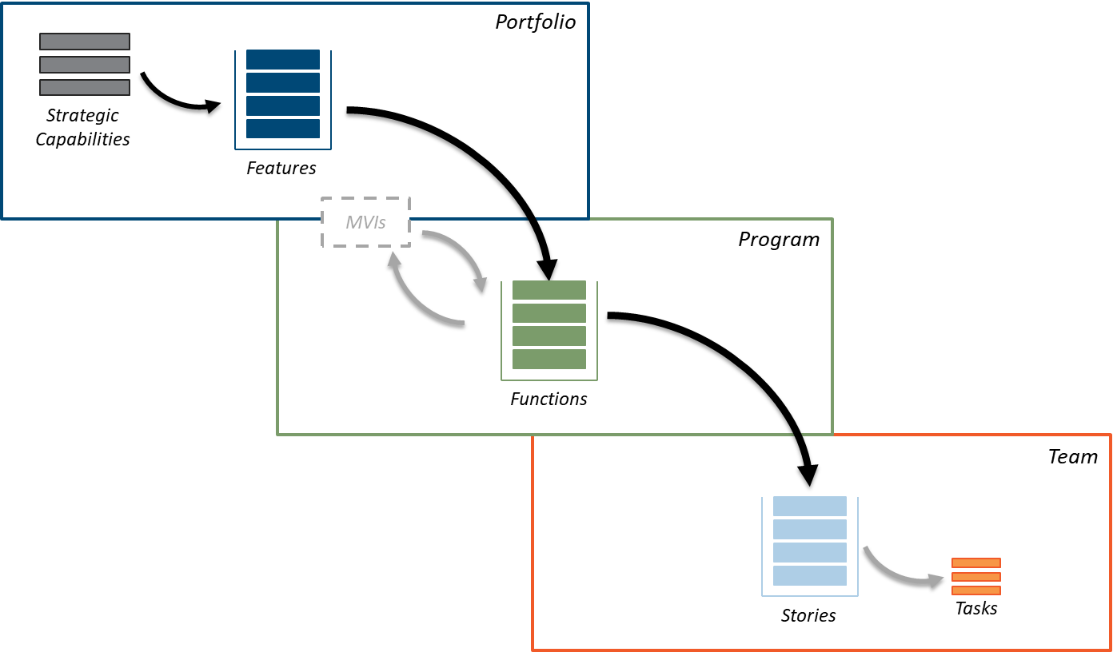
Lean-Agile Responsibility & Collaboration
Business & Tech collaboration is required in each layer of the model, but accountability shifts as value flows from strategy to execution.
High
Business leads; Tech supports.
Define Objectives & Vision
Organize, Prioritize & Plan
Business Accountability & Engagement
Deliver Incrementally
Business & Tech Share Ownership
Tech Leads; Business Supports.
Low
Technology Accountability & Engagement
High

Slide 12
Drive from Business Value - Example
Portfolio
Capability: Application Portfolio Management
Strategic Capabilities
Feature: Manage Asset Data
Features
MVPs
Function: Manage Asset Information
Program
Functions
Team
Stories
Tasks

Slide 13
Kingsmen Way
Kingsmen Software has been built on our ability to Set and Meet expectations
To set and meet expectations we need to be experts at Knowing the work (input) and Knowing our team (output)
Being experts requires the whole team to have an in-depth understanding of our client’s business and technology
Knowing the work requires us to have a repeatable methodology that allows us to build and communicate team knowledge
Knowing our team requires us to have a repeatable methodology that allows us to plan, track and measure team work
Fundamentals

